Slide 1
Operating Fire Hydrants
DSW

Slide 2
Proper Operation of Mueller Super Centurion Fire Hydrants
Safety
Opening and Closing
Proper Techniques and Tools
Signs that hydrant needs maintenance by a certified professional

Slide 3
Safety First
When approaching a Mueller Super Centurion Fire Hydrant for the first time, be sure to stand behind the hydrant on the backside. The backside of the hydrant is the location off of the road and away from the nozzles. The reason for this is because if the hydrant was turned on but never turned off, it is pressurized and the likely hood for the nozzles to blow off the hydrant are high.

Slide 4
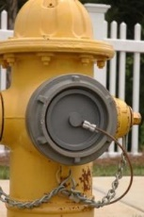
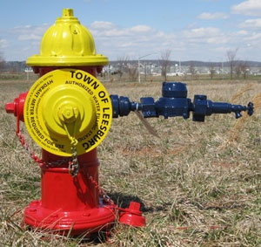
Step 2
Check smaller nozzle caps on both sides to make sure they are threaded on tight.
Take off one of the smaller nozzles if installing the hydrant meter. Be sure to hold meter while tightening up the nozzle cap.

Slide 5
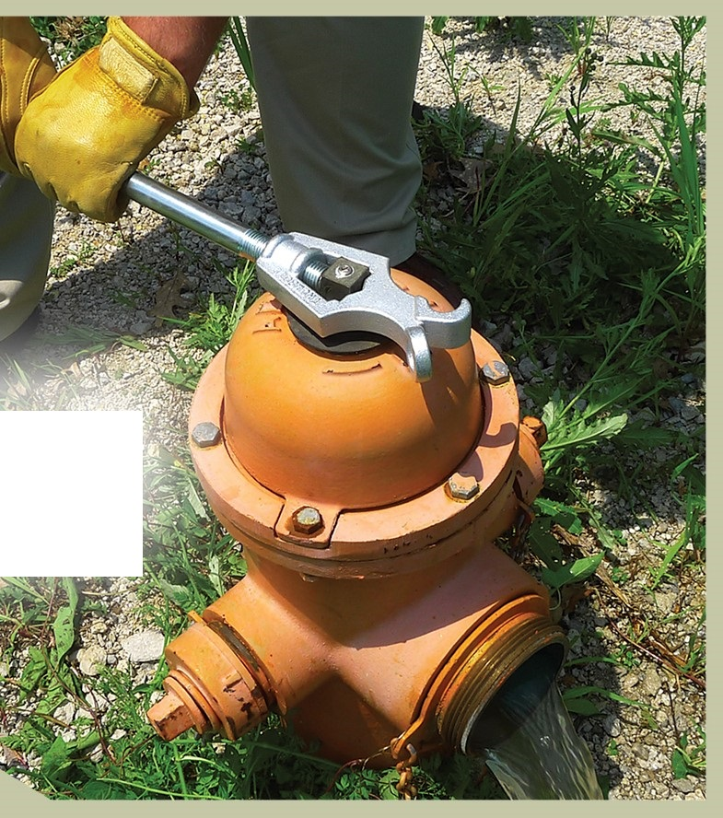
Step 3
After checking that all nozzle’s and hydrant meters are tight, open up valve located on the hydrant meter to the open position. Remember, open is turning the valve counter clockwise and closing the valve is clockwise. “Righty, Tighty- Lefty, Loosey”.
IMPORTANT- While standing behind the hydrant and using the proper hydrant wrench, begin to slowly open the hydrant using the operating nut located on top of the hydrant in a counter clockwise rotation. Hydrant must be fully open to eliminate water from leaving the barrel through underground drain ring. (16-15 full circle turns is open.) Once all the air is out of the hydrant water will start to come out of the meter, close e valve on meter set.

Slide 6
Step 4
Utilize the valve located on the meter set to control water flow on or off. Do not use hydrant to control the flow of the water.
After you are finished using the water slowly begin to close the hydrant.
Remember to stand behind the hydrant, while using the hydrant wrench, slowly turn the operating nut in a clockwise rotation counting 16-15 full rotation turns. Once fully closed, open the meter set valve to induce air into the barrel allowing the water to drain from the hydrant faster.

Slide 7
Final Step
After water has drained from the hydrant, remove the meter set from the nozzle using the proper wrench.
Replace the small nozzle cap back onto the hydrant, threading the cap back on just past hand tight with the wrench. Do not over tighten the cap because this could possibly loosen the internal threads from the casting of the hydrant.

Slide 8
Things to look for while operating the hydrant
Hard opening and closing hydrant- This could require maintenance from a certified professional hydrant specialist
Damaged or leaking nozzle caps.
Leaking hydrants
Rust or chipping paint
Cracked barrels
No flow or water to the Hydrant

Slide 9
In case of Malfunction of Hydrants
If there is ever a need for maintenance on hydrants a properly trained and certified professional should take care of all repairs. Hydrants are a vital tool in fighting and suppressing fires to limit property damage and save lives. Most people are not aware of the importance of these components to the community unless there is a desperate need for one. The importance of a properly maintained and operating hydrant is essential and should be inspected once a year for proper use. If you have any questions or concerns please call or email me directly.
DSW.Services@aol.com
10 years certified operator Transmission and Distribution water works

